Slide 1

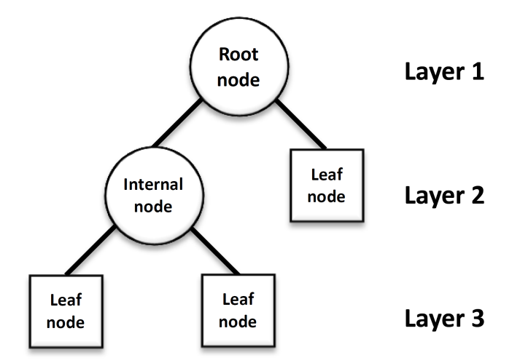
9) Tree Based Methods (Decision Trees)

Slide 2
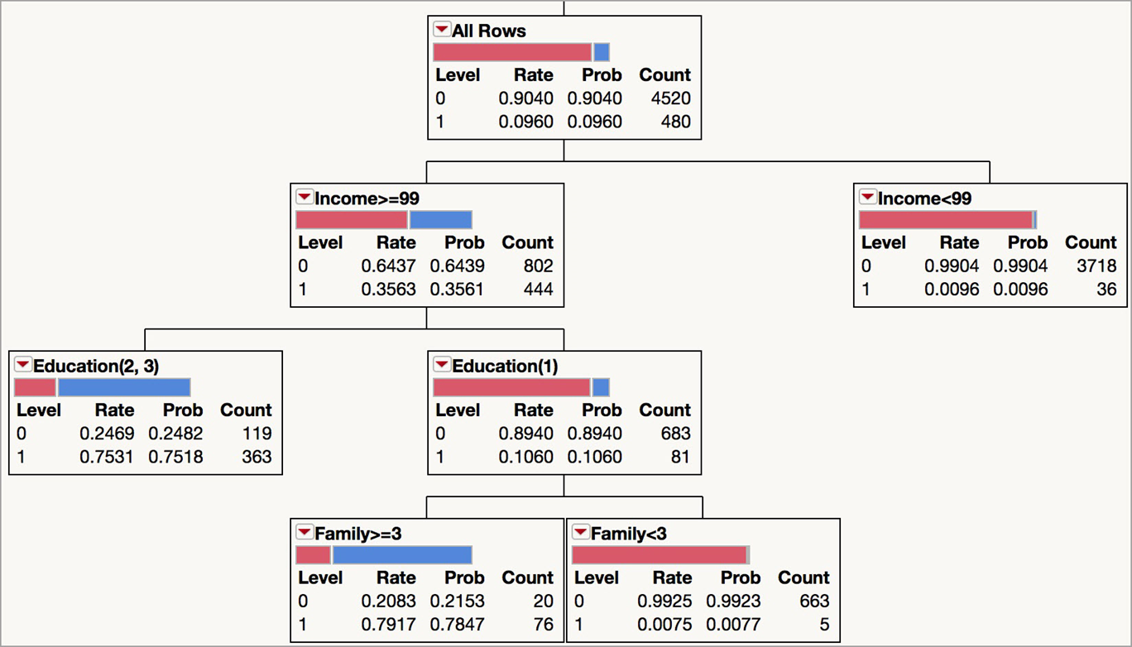

Tree Based Methods : Procedures that segment data sets through recursive partitioning utilizing a target or dependent variable and a set of predictor or explanatory variables.
Classification trees have qualitative target variables while the target variables for Regression trees are quantitative. Explanatory variables can be either qualitative or quantitative for either type of tree.
Example Classification Tree for a bank loan example relating the target variable (1=accept loan offer, 0=reject offer) with explanatory variables income, education, and family size.
From Figure 9.1, Shmueli, et al.
Ease of interpretation is an advantage of tree-based methods.
For the node in the blue box: If Income >=99 and Education =1 and Family >=3, classify as accept (Prob. accept=.7847)

Slide 3
Fundamental Concepts:
Growing a Tree- At each stage each predictor variable is examined along with the different ways the predictor can be split. The best predictor and split is selected based on what can provide the most differentiation between the resulting nodes, and the most homogeneity within nodes. A node that is completely homogeneous is called pure.
Stopping Rules- Different rules can be applied such as minimum node size, maximum tree size, p-value thresholds, and validation rules.
Overfitting- A danger with tree-based methods is overfitting where the tree doesn’t project well beyond the sample.
Tree Validation and Assessment – Assessing beyond the sample used to construct the tree
Classification – Classifying new observations

Slide 4
JMP for Classification and Regression Trees
JMP is a SAS software product that we will use for classification and regression trees. It is free to UGA students to load on their computers, and can be obtained at JMP Site License | Enterprise Information Technology Services
Once loaded, documentation about JMP can be found by clicking Help.
Classification and Regression Tree applications typically involve large data sets, but we will start with some small examples.
Classification Tree Example (adapted from Klimberg et al.) : After installing JMP, load the Freshman1.jmp data set. The data consists of 100 observations and variables that might be related to freshman attrition, along with the target variable Return that has values of 0 if the student did not return for their sophomore year, and 1 if they did return (qualitative target variable).
The explanatory variables are GPA, College, Accommodations (Dorm, off-campus, other), Attends office hours (Regularly, Sometimes, Never), Miles from home, Part-time work hours, and high school GPA.
Note that predictors can be quantitative or qualitative. Also, tree-based methods can easily handle missing values when present by treating them as a separate category.

Slide 5
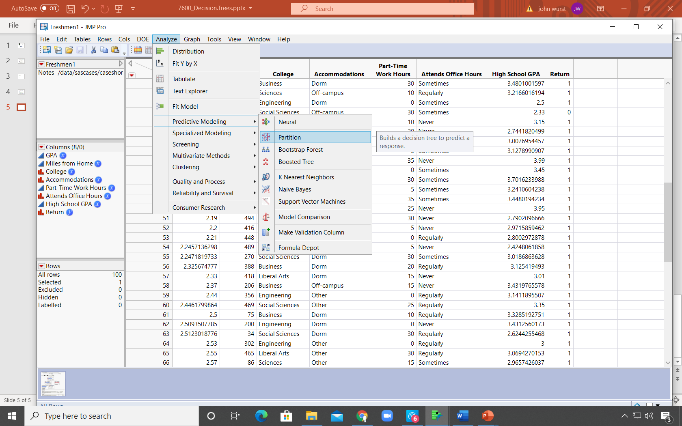
After opening the file Freshman1.jmp, click Analyze > Predictive Modeling > Partition

Slide 6
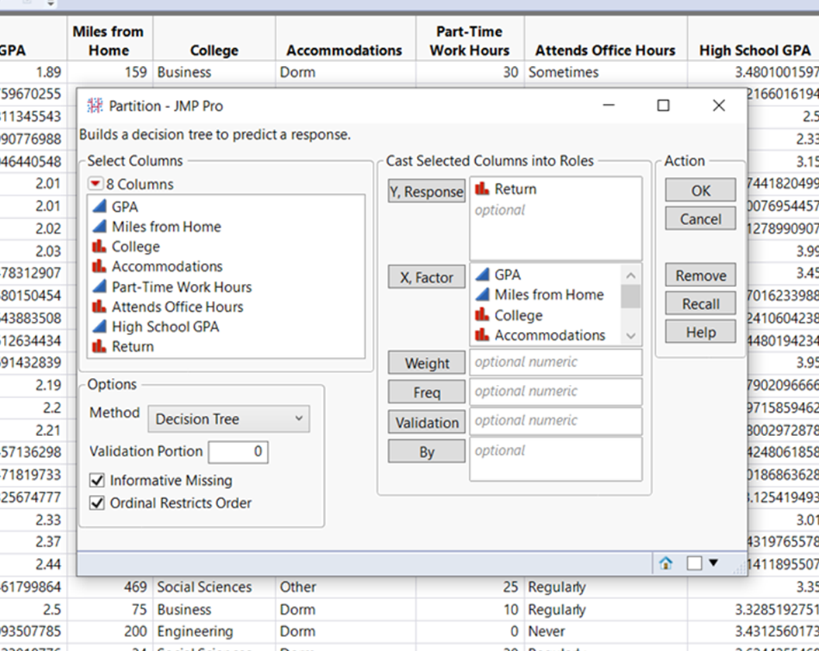
Classification Tree Example
Put Return in the Y, Response window, and all other variables in the X, Factor window, and click Ok

Slide 7
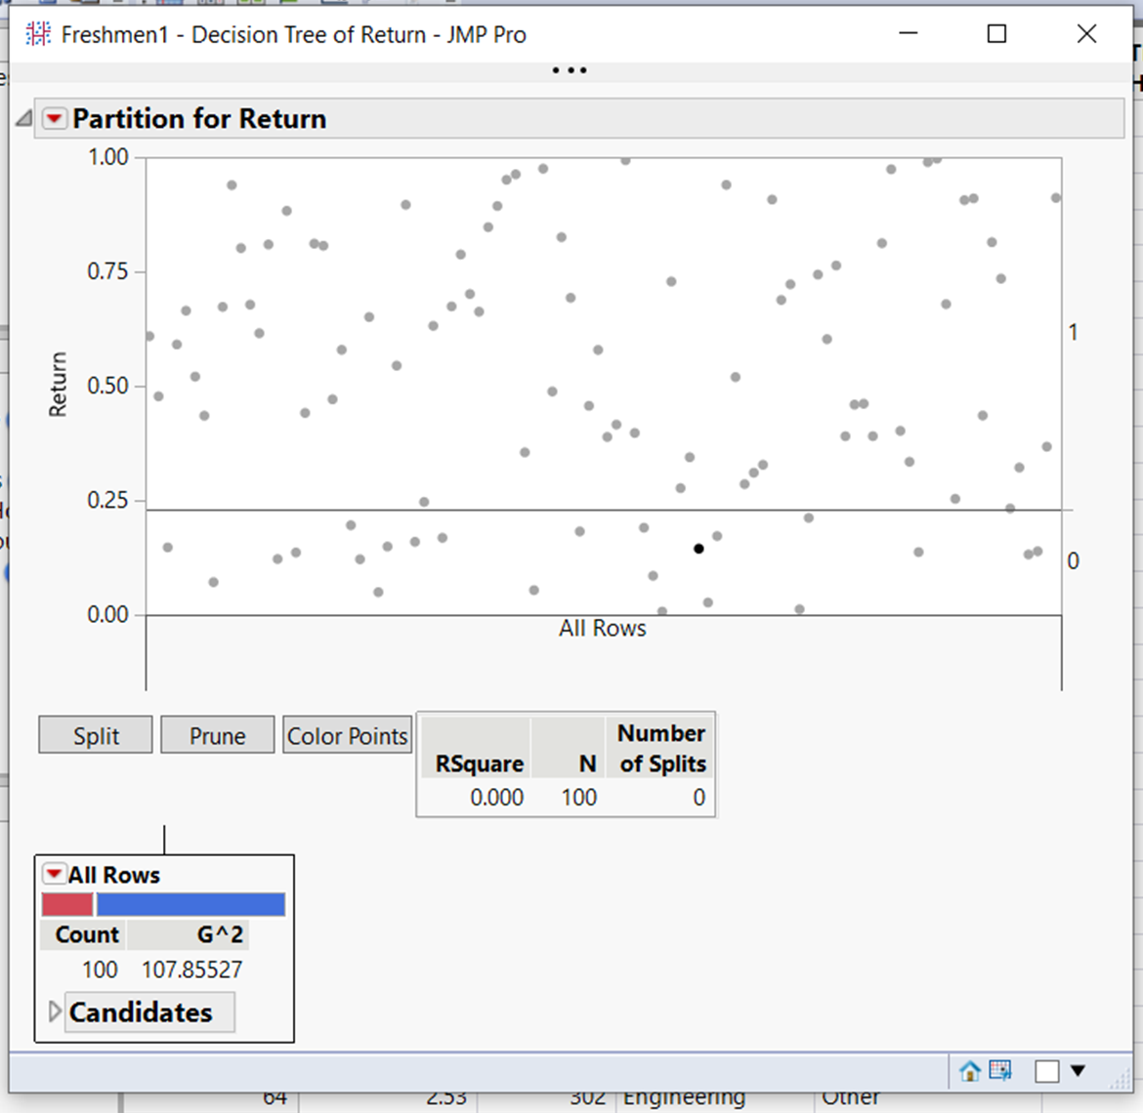
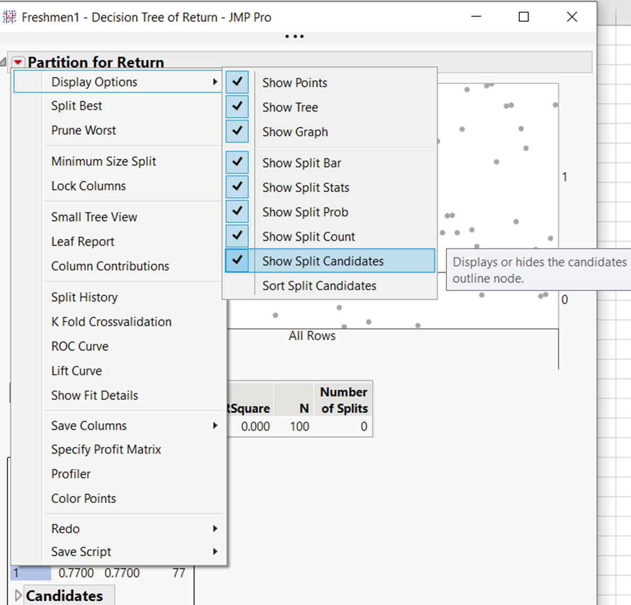
The graph displays the observations having a Return value of 1 (above the horizontal line) or 0 (below the line). RSquare is a fit measure that varies between 0 and 1 (larger values, better fit) which is currently 0 since there aren’t any splits yet. The node G^2 is a measure of node homogeneity. Pure nodes (all observations falling into one category) will have a G^2 = 0. Greater heterogeneity is associated with larger G^2 values (See the appendix for the node G^2 calculation)
To get more information in the nodes, click the red triangle to the left of “Partition for Return” and click Show Split Count and Show Split Prob.

Slide 8
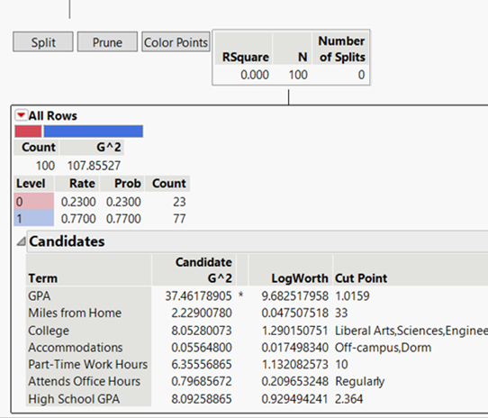
Note the Rate, which is the proportion of 0s and 1s in the node, the associated probabilities, and counts. Below that are the candidate explanatory variables for the first split.
The variable for the first split, and how that variable will be split, is determined by the largest LogWorth. Note that it is GPA, and the cut point for GPA is 1.0159.
That variable and cut point will produce the most significant split based on a Chi-square statistic (Details in the Appendix).
The LogWorth is a function of the P-Value for the Chi-square test. Specifically, LogWorth = -Log10(P-Value*). Splits are determined by the largest LogWorth (translates to the smallest P-Value). The reason LogWorths are used instead of the P-values directly is because many applications have large sample sizes, resulting in small P-Values which can be difficult to compare visually. LogWorths are easier to compare in those cases.
(*Note: The P-Values are adjusted to account for multiple splits)

Slide 9

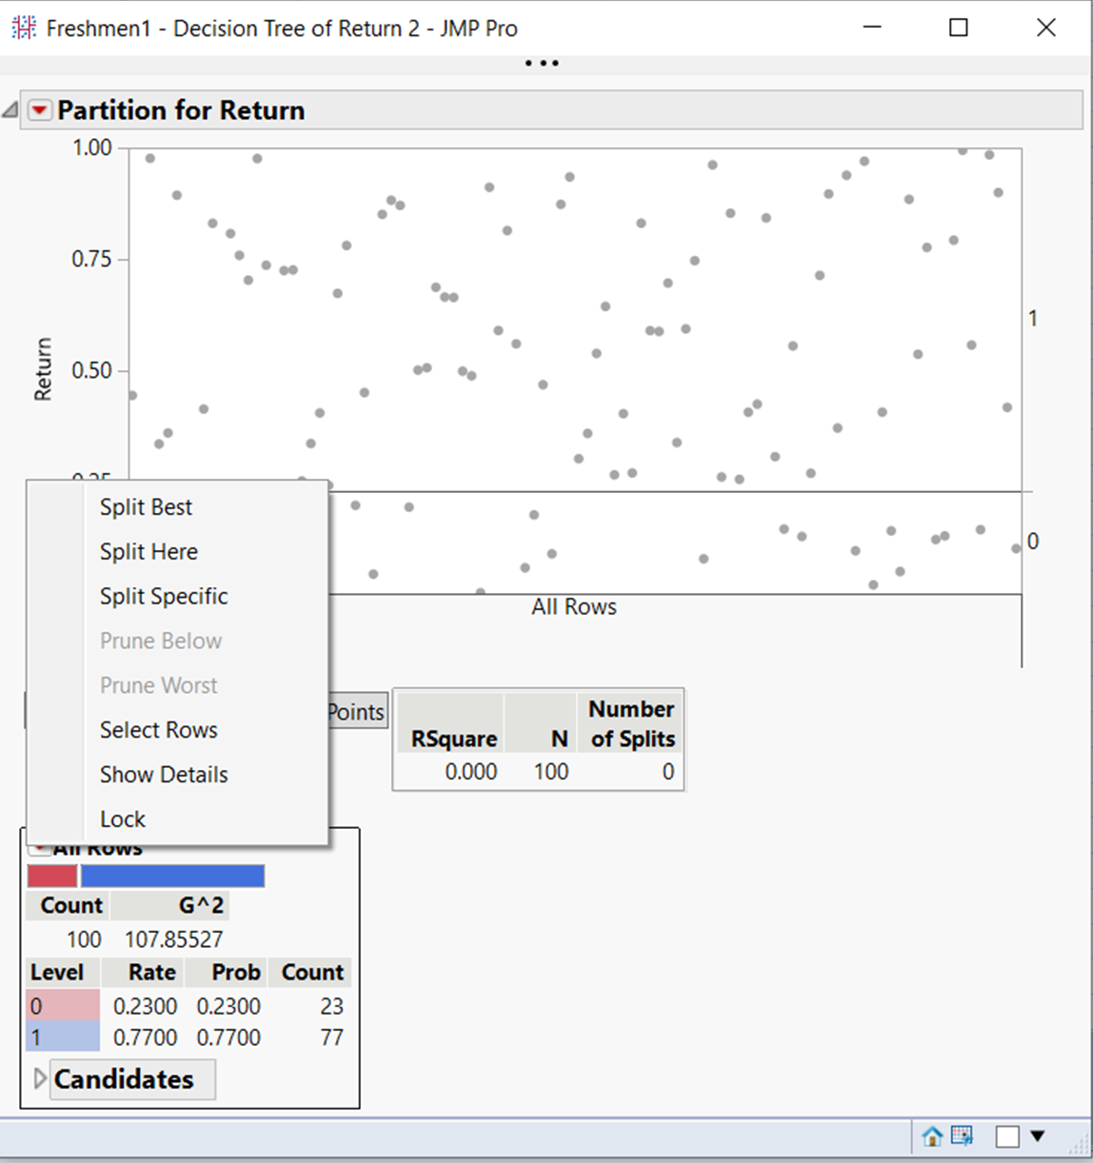
Clicking on the red triangle in the node shows the menu for “Split Best” (split on the most significant considering the tree), “Split Here” (split on the best from the current node) and “Split Specific” (split on the candidate variable selected by the user).
Also, to split on the most significant considering the tree, can click the “Split” button

Slide 10
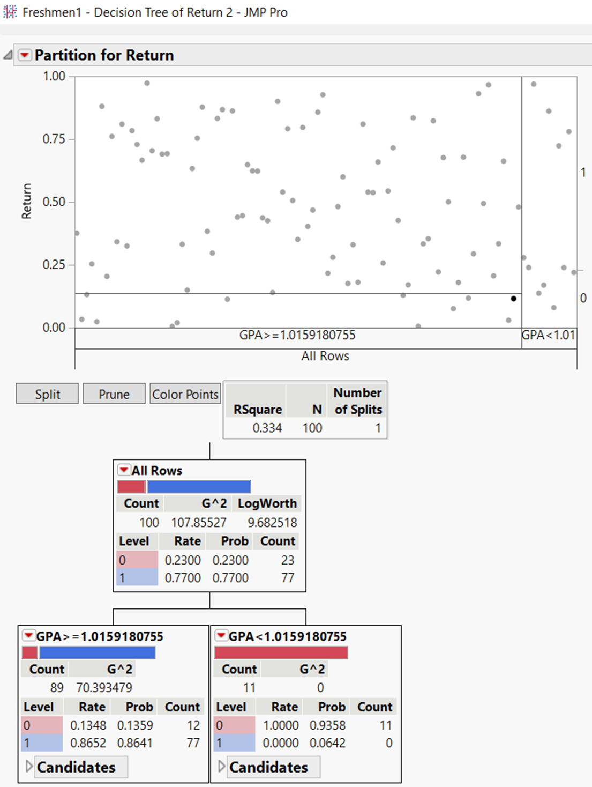
Clicking “Split” produces the following tree, split on GPA as expected. Note the node with GPA < 1.0159 is pure (only contains respondents that did not return). The graph has rectangles showing divisions based on the split, but the tree is the standard display.
The RSquare has increased to .334. This is actually a pseudo RSquare (different from the standard regression Rsquare), that accommodates the qualitative target variable
Clicking on “Split” again produces the tree on the next slide

Slide 11
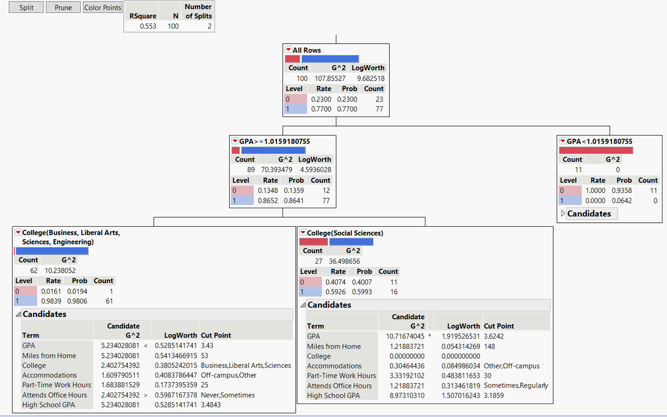
Growing the Tree and Stopping Rules
The resulting split shows social science students with a 59/41 ratio of returns to non-returns, while the other colleges have almost all returning. To determine the next split, the largest Logworth in either of the two new nodes is for GPA, which is the next optimal split.
As mentioned previously, one strategy is to continue growing the tree as long as the splits are significant for some threshold level. Using the .05 level, the split P-Value would need to be less than .05 which translates to needing a LogWorth greater than –(log10(.05)) = 1.3. Using that rule produces the tree on the next slide.

Slide 12
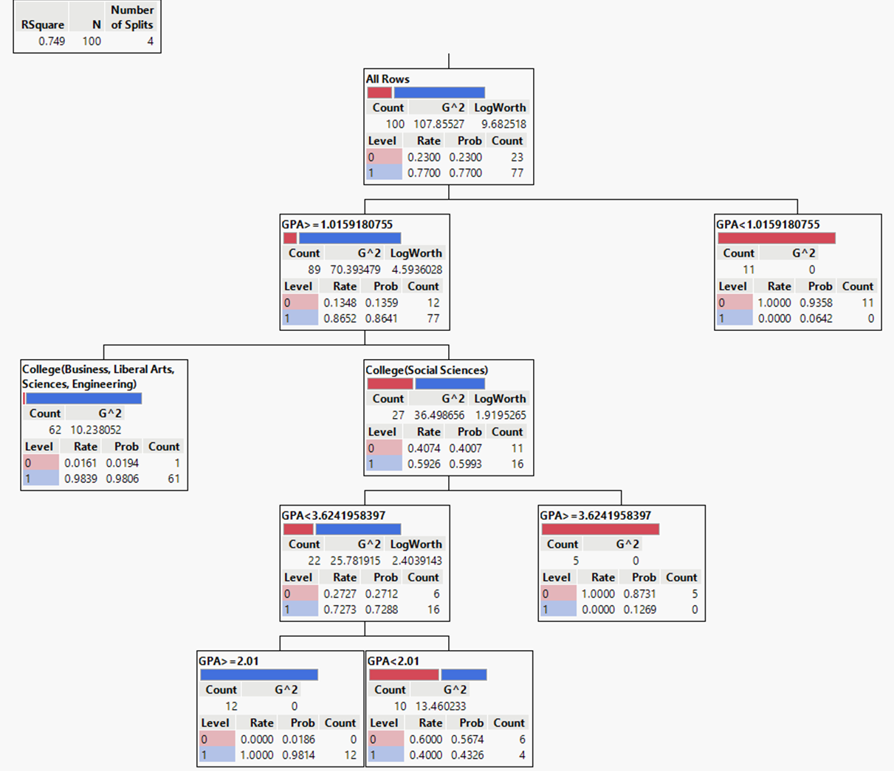
The node with GPA < 2.01 cannot be split further since the candidate there with the largest LogWorth for splitting has a value of .279 (or P-Value = .526). Since no node can be split further, we have the final tree (all terminal nodes)
Note that by default JMP requires nodes to have at least 5 observations, but that can be changed (by clicking the red triangle next to Partition for Return, and then Minimum Size Split).

Slide 13
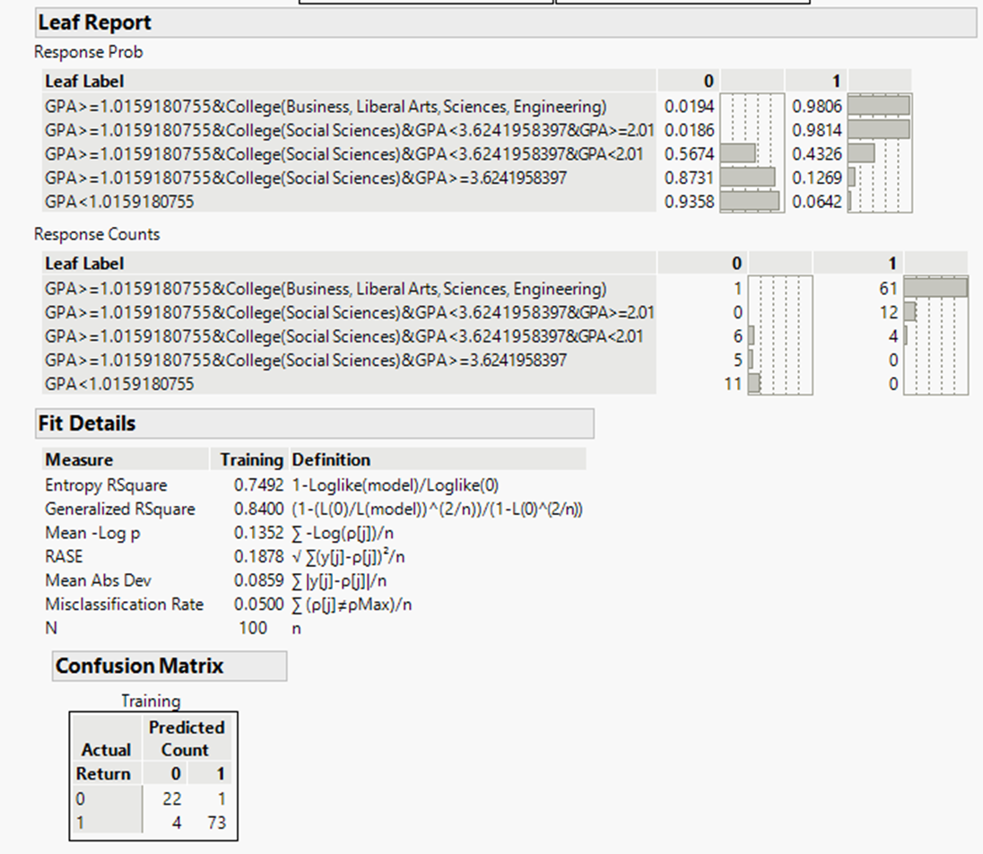
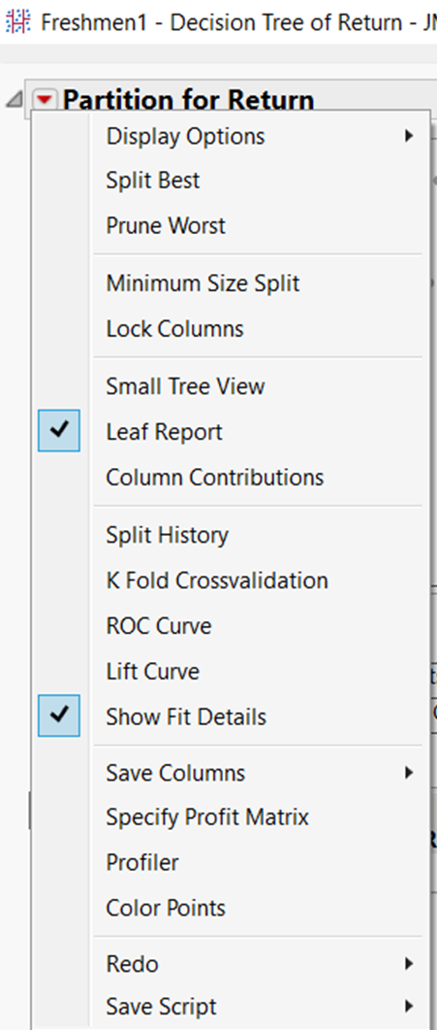
Fit measures and the Leaf Report showing classification rules and the resulting leaf counts and estimated probabilities are shown below for the final tree
The Confusion or Classification matrix shows how well the tree predicts the training sample, which was the total sample for this example. Validation and Test samples provide better assessment information, which will be discussed later

Slide 14
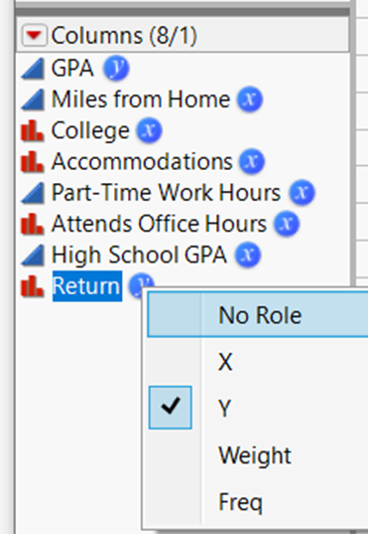
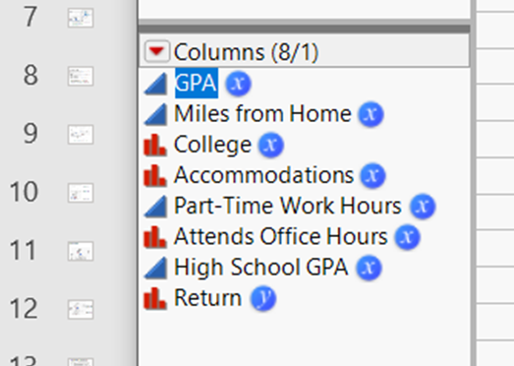
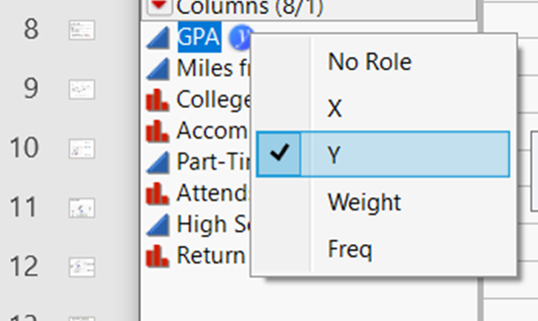
Regression Tree Example
Regression trees have quantitative target variables. Like classification trees, regression tree splits are determined by the largest LogWorth (smallest p-value). However, the LogWorth is obtained based on the F statistic to produce the split with the largest separation in the target variable means.
As an example, suppose we are interested in constructing a tree with GPA as the target variable using the Freshman1.jmp dataset. We can change the role of GPA from an “X” variable to a “Y” variable by clicking on its blue icon in the data table.
We also need to exclude Return which can be done by clicking on its blue icon and changing the role from “Y” to “No Role”.

Slide 15
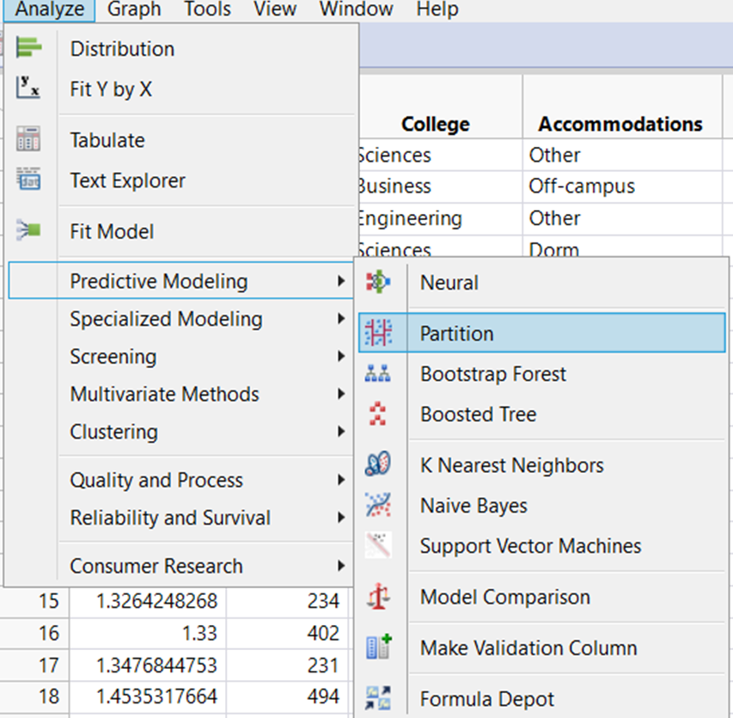
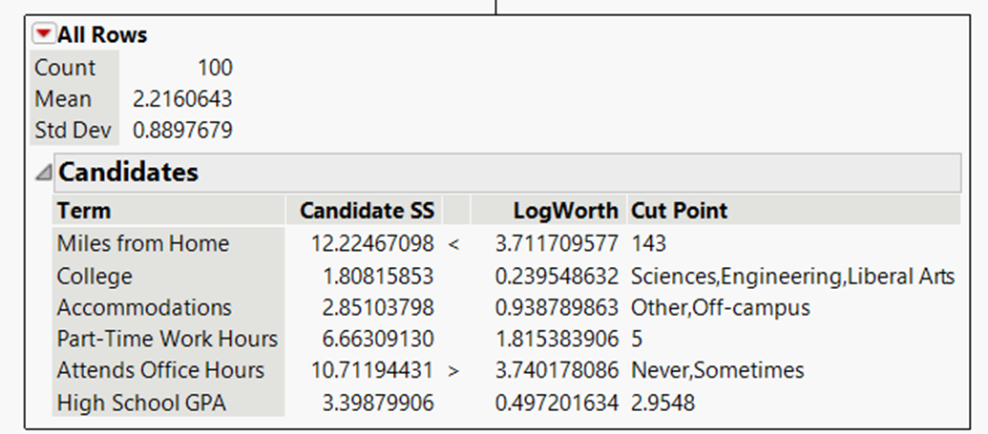
Clicking Analyze > Predictive Modeling > Partition will produce the initial node displaying the Count, along with the mean and standard deviation of the target variable GPA.
Clicking to reveal the Candidates shows Attends Office Hours has the largest LogWorth. Clicking on Split produces the tree on the next slide

Slide 16
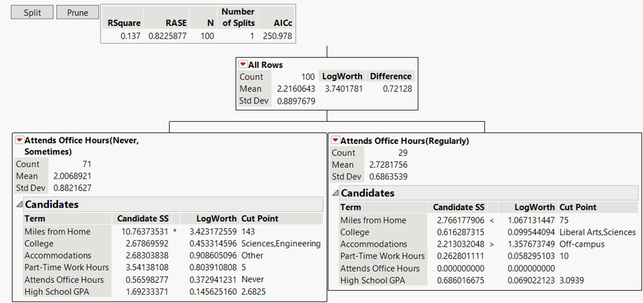
As expected, Attends Office Hours is split.
Continuing, we see from the LogWorths that Miles from Home will be split from the Attends Office Hours (Never, Sometimes) node.
Note Difference is the difference in the GPA means. Candidate SS is the difference in sums of squares that would result from splitting on that variable (reduction in SS).
Clicking Split produces the tree on the next slide.

Slide 17
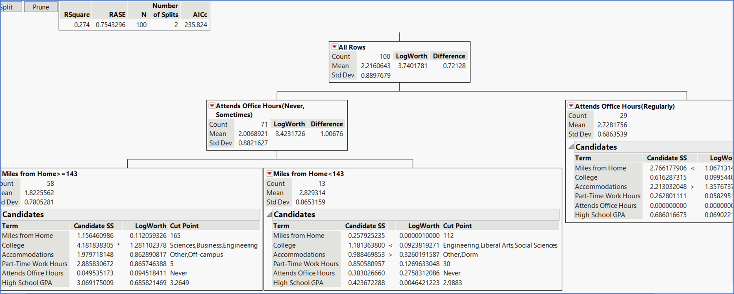
As expected, Miles from Home is split.
Still Continuing, we see from the LogWorths that Accommodations will be split from the Attends Office Hours (Regularly) node. Clicking Split produces the tree on the next slide.

Slide 18
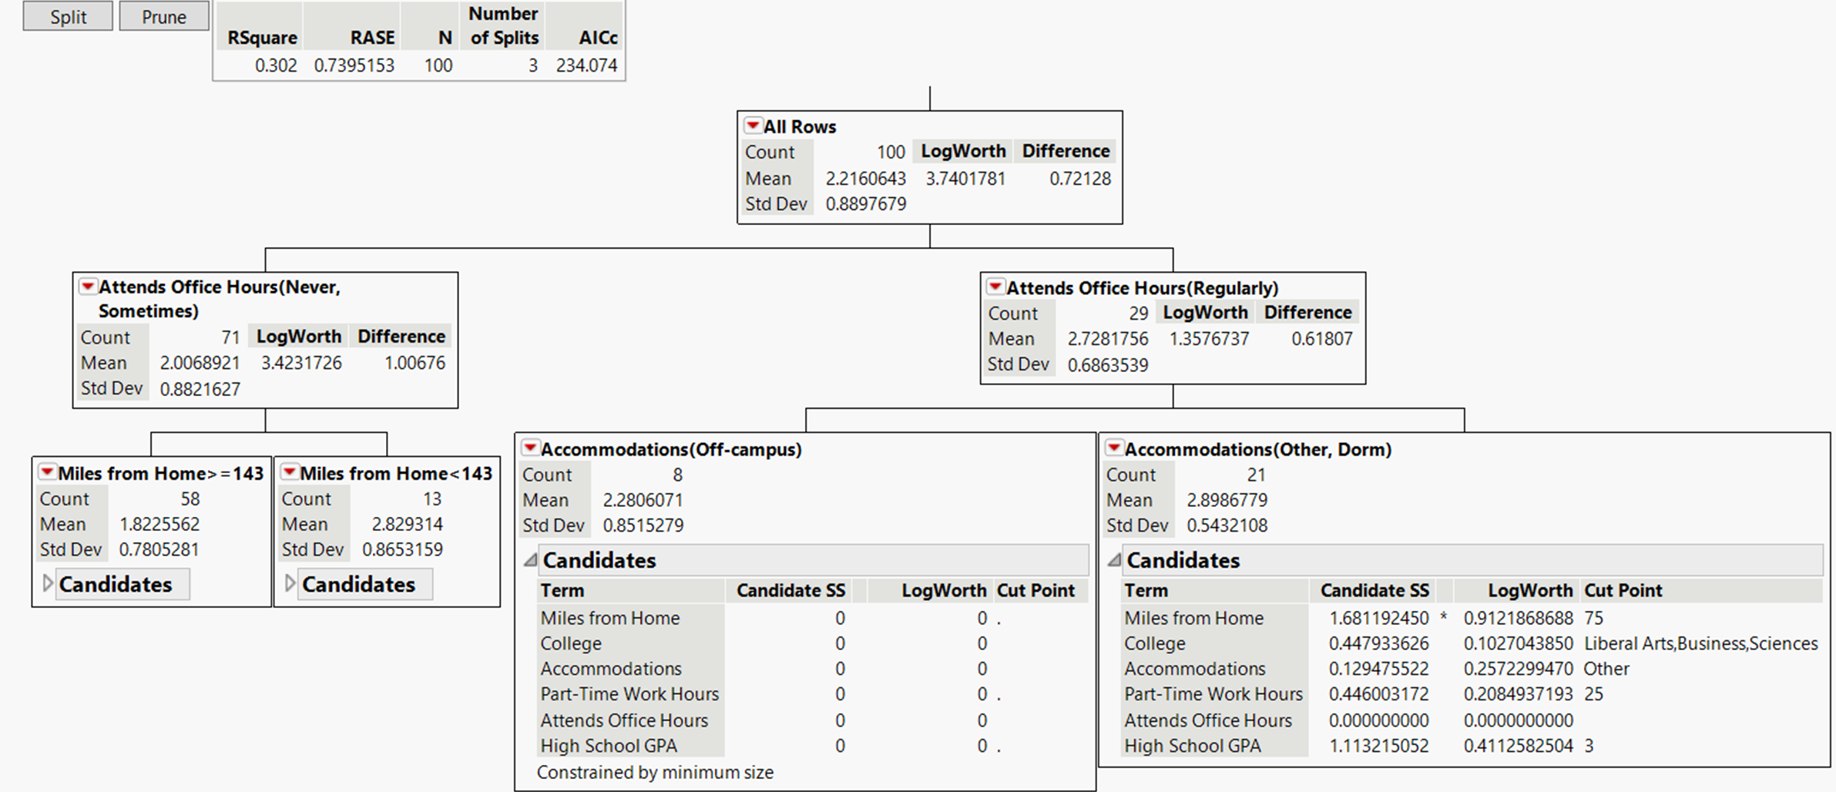
At this point, no LogWorth has a value greater than 1.3 (p-value < .05), and also note the Accommodations (Off-campus) is constrained by minimum size. Using the .05 level stopping rule, this is the final tree.

Slide 19
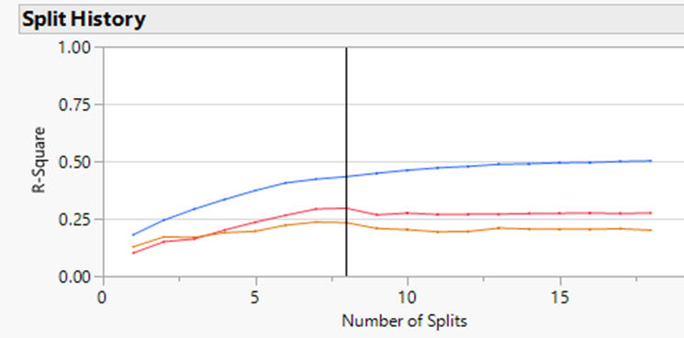
Growing the Tree Automatically with “Go” in JMP
Clicking “Go”, JMP will produce a tree by first growing it using a training sample, and then pruning it back to a size determined by the maximum r-square for a validation sample. In addition, an optional test sample, independent of the tree development process, can be used to assess the tree.
Note that as a decision tree grows, it will reach a point where it begins to overfit, modeling the noise in the data. In fact, it is possible for a decision tree to fit a data set perfectly (r-square = 1) if grown far enough.
To avoid overfitting, the “Go” procedure requires the user to specify a validation sample. The tree is grown using the training sample, and fit to the validation sample at each step. While the r-square for both the training and validation sample can increase initially, at a certain point the tree can start to overfit the training sample, and as growth continues the r-square for the training sample can be expected to continue increasing (it can’t decrease). However, as overfitting increases, the r-square for the validation sample is expected to decrease.
To avoid overfitting, the tree is grown to where the r-square for the validation sample stops increasing, and then for 10 more splits. If the validation r-square doesn’t increase further, the tree is pruned back to the point of the validation sample maximum r-square.
Example: Split history for a run resulting in a tree with 8 splits
Training
Validation
Test

Slide 20
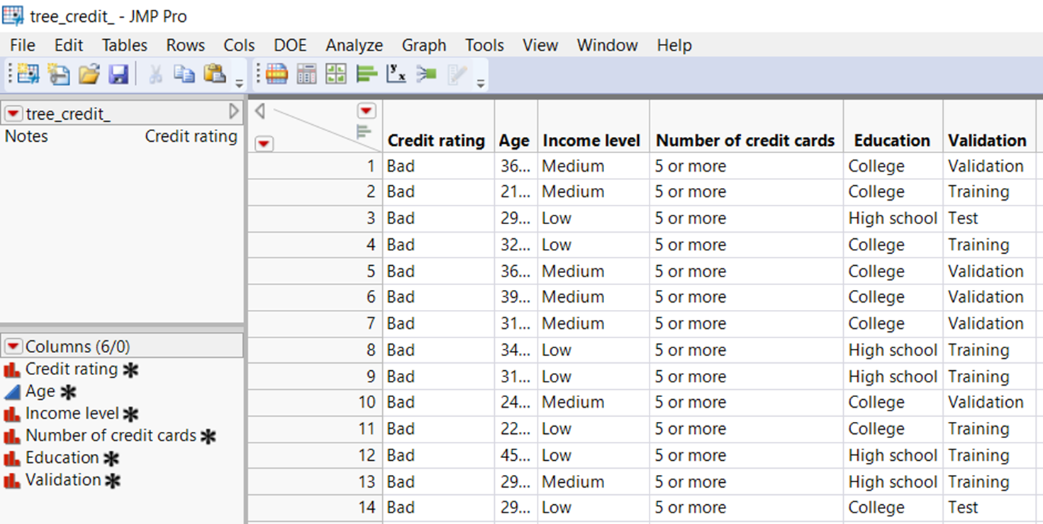
Example: Growing a tree automatically with “Go” in JMP
File “tree_credit_.jmp contains 2464 records with a variable “Credit Rating” classifying a person as a “high” or “low” credit risk. There’s interest in examining the potential relation between that rating and the explanatory variables: Age, Income level, Number of credit cards, and Education. In addition, there’s a variable “Validation” that identifies the sample subsets to be used as the training, validation, and testing portions in building and assessing the classification tree.

Slide 21
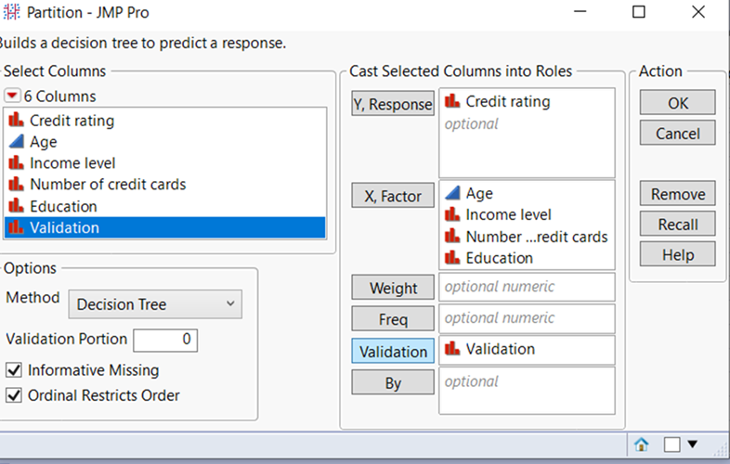
In addition to the target and explanatory variables, the Validation variable should be loaded into the “Validation” window.
Note: A Test sample is optional, and if only a training and validation sample is desired, the validation sample can be automatically created by specifying the desired proportion of the data set for validation in the “Validation Portion” window (e.g., change the 0 to .3 for 30% validation sample). A Validation variable is not needed in that case, but could be used instead if desired (specifying only the training and validation records in the data set).

Slide 22
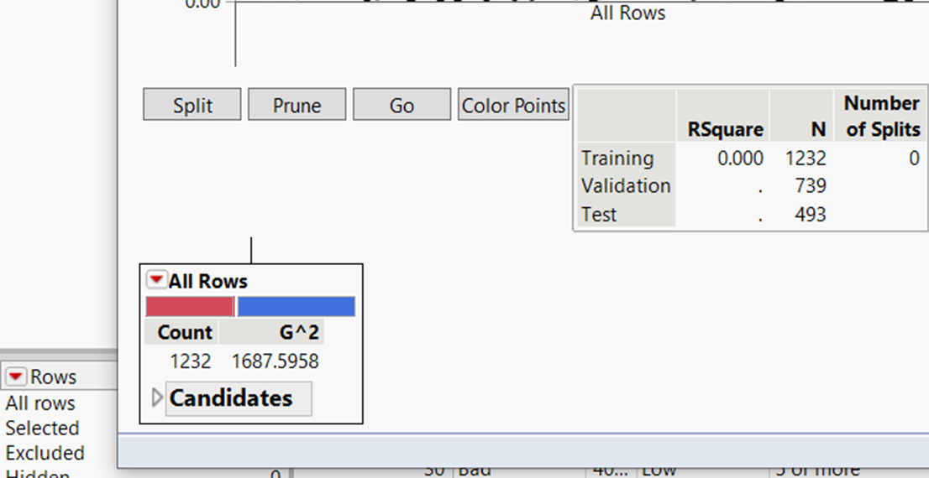
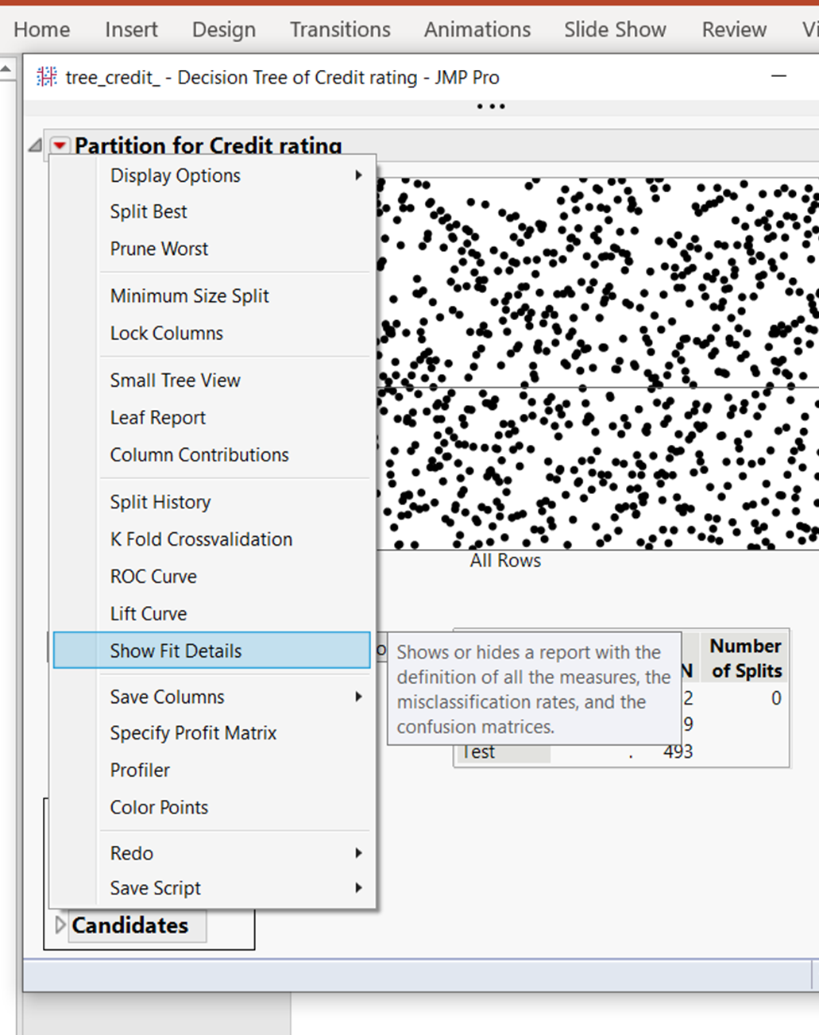
Click Go to automatically grow the tree
Click Small Tree View to get a reduced version of the tree (useful for large trees)
Click Show Fit Details to display fit measures and confusion/classification matrices

Slide 23
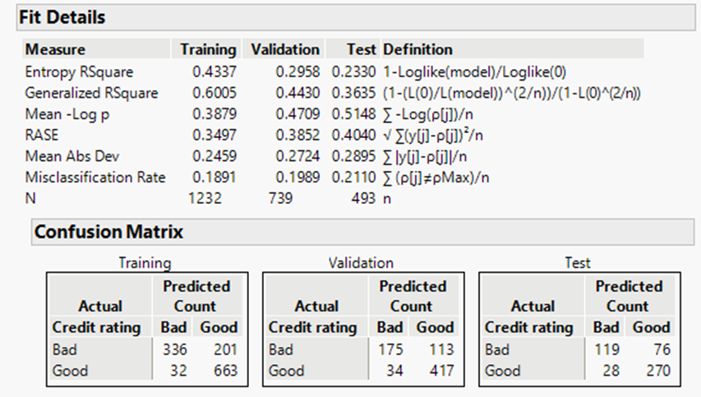
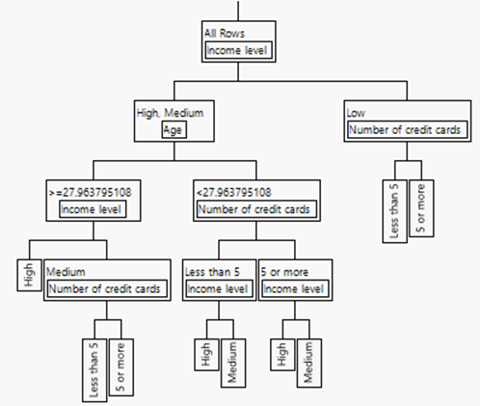
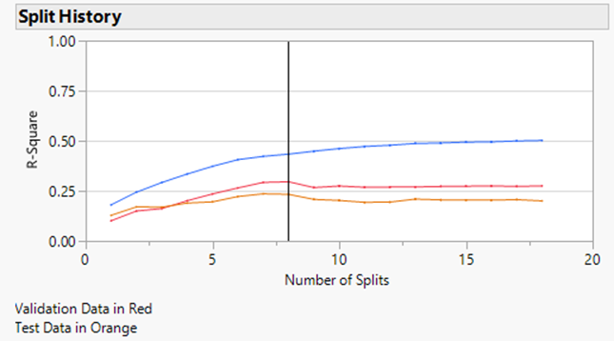
Prediction can be assessed by reviewing the Confusion/ Classification Matrix for the Test Sample.

Slide 24
Decision Tree Pluses and Minuses
Decision Trees are relatively easy to implement, require little data preparation, easily handle missing values, and are relatively easy to interpret and explain. They can be very useful for determining explanatory variable importance, and used as a preliminary step to other modeling methods.
While decision trees can be used for prediction, they typically do not perform as well as other common modeling methods (e.g., discriminant analysis and logit modeling). They can experience high variability. To improve predictive performance, ensemble methods have been developed (e.g., random forests) where multiple trees are developed and predictions produced through combining methods. However, these ensemble methods lose interpretability, one of the important advantages of decision trees.

Slide 25
Added Application
The rate of customer loss over time is called churn. Churn_.jmp is a cell phone customer data file with 6667 records containing variables Churn (1=customer left, 0=customer stayed), Mins, Intl_Plan, Account_Length, Cust_Serv_Call, Gender, and Validation (used to divide the data into training (50%), validation (30%), and test (20%) subsamples).
Analyze churn by using a classification tree. Grow the tree with GO in JMP using the Validation variable to specify the training, validation, and test samples.
How many splits in the final tree?
Interpret the tree.
Characterize segments most likely and least likely to churn.
Assess the predictive ability of the tree using the confusion/classification matrix of the test sample.

Slide 26
Appendix

Slide 27
References
Klimberg R., McCullough B.D., Fundamentals of Predictive Analytics with JMP, 2nd Edition, SAS (Chapter 10)
Available online from UGA Libraries
Shmueli G., Bruce P.C., Stephens M.L., Patel N.R., Data Mining for Business Analytics: Concepts, Techniques, and Applications with JMP PRO, Wiley (Chapter 9)
Available online from UGA Libraries

